Slide 1
Support RISC-V Prefetch Instructions in Gem5

Slide 2
RISCV Prefetch Instructions
prefetch.i
Synopsis: Provide a HINT to hardware that a cache block is likely to be accessed by an instruction fetch in the near future
Mnemonic: prefetch.i offset(base)
prefetch.r
Synopsis: Provide a HINT to hardware that a cache block is likely to be accessed by a data read in the near future
Mnemonic: prefetch.r offset(base)
prefetch.w
Synopsis: Provide a HINT to hardware that a cache block is likely to be accessed by a data write in the near future
Mnemonic: prefetch.w offset(base)
Notes:
RISCV的PMU发展，是一个逐步通用化、精细化的过程
29个HPM counters，处理器厂家可以自行选择实现多少个
寄存器最大64位，处理器厂家也可以自行选择实现多少位，比如40位

Slide 3
Add RISCV Prefetch Instructions in Gem5 -- Decode
decode QUADRANT default Unknown::unknown() {
0x03: decode OPCODE {
…
0x04: decode FUNCT3 {
0x6: decode RD {
0x00: decode PFTYPE {
format PrefetchOp {
0x0: Prefetch_i({{
}}, inst_flags=IsInstPrefetch, mem_flags=PREFETCH);
0x1: Prefetch_r({{
}}, inst_flags=IsDataPrefetch, mem_flags=PREFETCH);
0x3: Prefetch_w({{
}}, inst_flags=IsDataPrefetch, mem_flags=PF_EXCLUSIVE);
}
}
default: IOp::ori({{
Rd = Rs1 | imm;
}}, uint64_t);
}
}
Notes:
RISCV的PMU发展，是一个逐步通用化、精细化的过程
29个HPM counters，处理器厂家可以自行选择实现多少个
寄存器最大64位，处理器厂家也可以自行选择实现多少位，比如40位

Slide 4
Add RISCV Prefetch Instructions in Gem5
Prefetch_i::Prefetch_i(ExtMachInst machInst):
PrefetchOp("Prefetch_i", machInst, MemReadOp) {
setRegIdxArrays(
reinterpret_cast<RegIdArrayPtr>(
&std::remove_pointer_t<decltype(this)>::srcRegIdxArr),
reinterpret_cast<RegIdArrayPtr>(
&std::remove_pointer_t<decltype(this)>::destRegIdxArr));
;
setSrcRegIdx(_numSrcRegs++, ((RS1) == 0) ? RegId() : RegId(IntRegClass, RS1));
flags[IsInstPrefetch] = true;
flags[IsInteger] = true;
flags[IsLoad] = true;
memAccessFlags = Request::PREFETCH;;
offset = sext<12>(IMM5 | (IMM7 << 5));;
}
class Prefetch_i : public PrefetchOp
{
private:
RegId srcRegIdxArr[1]; RegId destRegIdxArr[0];
public:
/// Constructor.
Prefetch_i(ExtMachInst machInst);
Fault execute(ExecContext *, Trace::InstRecord *) const override;
Fault initiateAcc(ExecContext *, Trace::InstRecord *) const override;
Fault completeAcc(PacketPtr, ExecContext *,
Trace::InstRecord *) const override;
};
Notes:
RISCV的PMU发展，是一个逐步通用化、精细化的过程
29个HPM counters，处理器厂家可以自行选择实现多少个
寄存器最大64位，处理器厂家也可以自行选择实现多少位，比如40位

Slide 5
Add RISCV Prefetch Instructions in Gem5
Atomic
Timing
Fault Prefetch_i::initiateAcc(ExecContext *xc,
Trace::InstRecord *traceData) const {
Addr EA;
uint64_t Rs1 = 0;
int32_t Mem = {};
Rs1 = xc->getRegOperand(this, 0);
EA = Rs1 + offset;;
return initiateMemRead(xc, traceData, EA, Mem, memAccessFlags);
}
Fault Prefetch_i::completeAcc(PacketPtr pkt,
ExecContext *xc, Trace::InstRecord *traceData) const {
return NoFault;
}
Fault
Prefetch_i::execute(ExecContext *xc,
Trace::InstRecord *traceData) const
{
Addr EA;
uint64_t Rs1 = 0;
int32_t Mem = {};
Rs1 = xc->getRegOperand(this, 0);
EA = Rs1 + offset;;
readMemAtomicLE(xc, traceData, EA, Mem, memAccessFlags);
return NoFault;
}
Notes:
RISCV的PMU发展，是一个逐步通用化、精细化的过程
29个HPM counters，处理器厂家可以自行选择实现多少个
寄存器最大64位，处理器厂家也可以自行选择实现多少位，比如40位

Slide 6
Gem5’s Trap Handling for Prefetch Instructions
void
IEW::executeInsts()
{
if (inst->isMemRef()) {
if (inst->isAtomic()) {
…
} else if (inst->isLoad()) {
fault = ldstQueue.executeLoad(inst);
if (inst->isTranslationDelayed() &&
fault == NoFault) {
// A hw page table walk is currently going on; the
// instruction must be deferred.
DPRINTF(IEW, "Execute: Delayed translation, deferring "
"load.\n");
instQueue.deferMemInst(inst);
continue;
}
if (inst->isDataPrefetch() || inst->isInstPrefetch()) {
inst->fault = NoFault;
}
} else if
…
Notes:
RISCV的PMU发展，是一个逐步通用化、精细化的过程
29个HPM counters，处理器厂家可以自行选择实现多少个
寄存器最大64位，处理器厂家也可以自行选择实现多少位，比如40位

Slide 7
Gem5’s MemAcc Handling for Prefetch Instructions
packet.hh
packet.cc
static MemCmd
makeReadCmd(const RequestPtr &req)
{
if (req->isHTMCmd()) {
if (req->isHTMAbort())
return MemCmd::HTMAbort;
else
return MemCmd::HTMReq;
} else if (req->isLLSC())
return MemCmd::LoadLockedReq;
else if (req->isPrefetchEx())
return MemCmd::SoftPFExReq;
else if (req->isPrefetch())
return MemCmd::SoftPFReq;
else if (req->isLockedRMW())
return MemCmd::LockedRMWReadReq;
else
return MemCmd::ReadReq;
}
const MemCmd::CommandInfo
MemCmd::commandInfo[] =
{
/* SoftPFReq */
{ {IsRead, IsRequest, IsSWPrefetch, NeedsResponse},
SoftPFResp, "SoftPFReq" },
/* SoftPFExReq */
{ {IsRead, NeedsWritable, IsInvalidate, IsRequest,
IsSWPrefetch, NeedsResponse}, SoftPFResp, "SoftPFExReq" },
/* HardPFReq */
{ {IsRead, IsRequest, IsHWPrefetch, NeedsResponse, FromCache},
HardPFResp, "HardPFReq" },
/* SoftPFResp */
{ {IsRead, IsResponse, IsSWPrefetch, HasData}, InvalidCmd, "SoftPFResp" },
...
}
Notes:
RISCV的PMU发展，是一个逐步通用化、精细化的过程
29个HPM counters，处理器厂家可以自行选择实现多少个
寄存器最大64位，处理器厂家也可以自行选择实现多少位，比如40位

Slide 8
Gem5’s MemAcc Handling for Prefetch Instructions
if (!mshr) {
// copy the request and create a new SoftPFReq packet
RequestPtr req = std::make_shared<Request>(pkt->req->getPaddr(),
pkt->req->getSize(),
pkt->req->getFlags(),
pkt->req->requestorId());
pf = new Packet(req, pkt->cmd);
pf->allocate();
assert(pf->matchAddr(pkt));
assert(pf->getSize() == pkt->getSize());
}
pkt->makeTimingResponse();
// request_time is used here, taking into account lat and the delay
// charged if the packet comes from the xbar.
cpuSidePort.schedTimingResp(pkt, request_time);
// If an outstanding request is in progress (we found an
// MSHR) this is set to null
pkt = pf;
}
BaseCache::handleTimingReqMiss(pkt, mshr, blk, forward_time, request_time);
}
cache.cc
void
Cache::handleTimingReqMiss(PacketPtr pkt, CacheBlk *blk, Tick forward_time, Tick request_time) {
// Software prefetch handling:
// To keep the core from waiting on data it won't look at
// anyway, send back a response with dummy data. Miss handling
// will continue asynchronously. Unfortunately, the core will
// insist upon freeing original Packet/Request, so we have to
// create a new pair with a different lifecycle. Note that this
// processing happens before any MSHR munging on the behalf of
// this request because this new Request will be the one stored
// into the MSHRs, not the original.
if (pkt->cmd.isSWPrefetch()) {
PacketPtr pf = nullptr;
Notes:
RISCV的PMU发展，是一个逐步通用化、精细化的过程
29个HPM counters，处理器厂家可以自行选择实现多少个
寄存器最大64位，处理器厂家也可以自行选择实现多少位，比如40位

Slide 9
RISCV-GNU-Toolchain
riscv-binutils/include/opcode/riscv-opc.h
#define MATCH_PREFETCH_I 0x6013
#define MASK_PREFETCH_I 0x1f07fff
#define MATCH_PREFETCH_R 0x106013
#define MASK_PREFETCH_R 0x1f07fff
#define MATCH_PREFETCH_W 0x306013
#define MASK_PREFETCH_W 0x1f07fff
DECLARE_INSN(prefetch_i, MATCH_PREFETCH_I, MASK_PREFETCH_I)
DECLARE_INSN(prefetch_r, MATCH_PREFETCH_R, MASK_PREFETCH_R)
DECLARE_INSN(prefetch_w, MATCH_PREFETCH_W, MASK_PREFETCH_W)
riscv-binutils/include/opcode/riscv-opc.c
const struct riscv_opcode riscv_opcodes[] =
{
{"prefetch.i",64, INSN_CLASS_I, "q(s)", MATCH_PREFETCH_I, MASK_PREFETCH_I, match_opcode, 0 },
{"prefetch.r",64, INSN_CLASS_I, "q(s)", MATCH_PREFETCH_R, MASK_PREFETCH_R, match_opcode, 0 },
{"prefetch.w",64, INSN_CLASS_I, "q(s)", MATCH_PREFETCH_W, MASK_PREFETCH_W, match_opcode, 0 },
…
}
Notes:
RISCV的PMU发展，是一个逐步通用化、精细化的过程
29个HPM counters，处理器厂家可以自行选择实现多少个
寄存器最大64位，处理器厂家也可以自行选择实现多少位，比如40位

Slide 10
RISCV-GNU-Toolchain -- Test
int main() {
int a;
asm volatile ("prefetch.r %[addr]": : [addr]"A"(a));
}
0000000000010146 <main>:
10146: 1101 addi sp,sp,-32
10148: ec22 sd s0,24(sp)
1014a: 1000 addi s0,sp,32
1014c: fec40793 addi a5,s0,-20
10150: 0017e013 prefetch.r 0(a5)
10154: 4781 li a5,0
10156: 853e mv a0,a5
10158: 6462 ld s0,24(sp)
1015a: 6105 addi sp,sp,32
1015c: 8082 ret
Notes:
RISCV的PMU发展，是一个逐步通用化、精细化的过程
29个HPM counters，处理器厂家可以自行选择实现多少个
寄存器最大64位，处理器厂家也可以自行选择实现多少位，比如40位

Slide 11
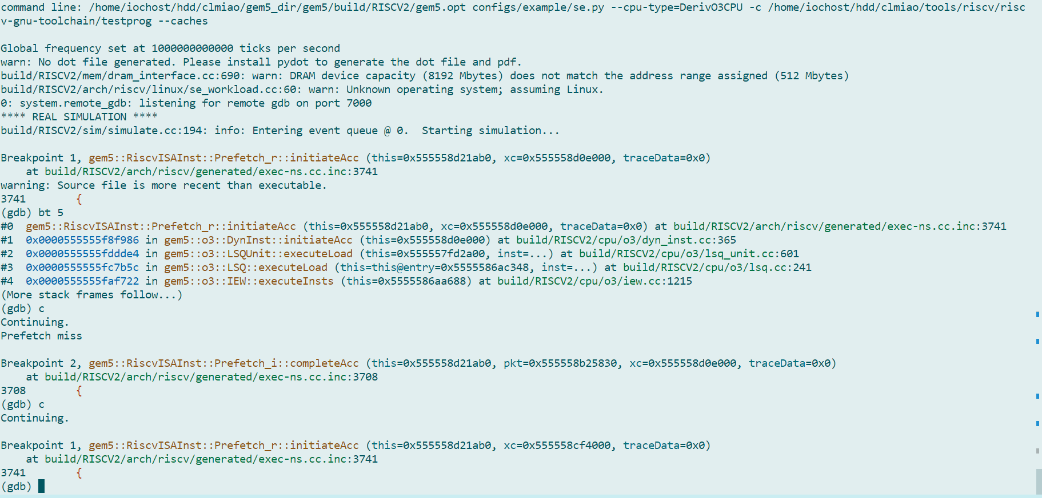
Test – GDB

Slide 12
Test – Matrix Addition
#include <stdlib.h>
#include <gem5/m5ops.h>
const int MATRIX_SIZE = 100;
int main() {
int** matA = (int**)malloc(MATRIX_SIZE * sizeof(int*));
int** matB = (int**)malloc(MATRIX_SIZE * sizeof(int*));
int** matC = (int**)malloc(MATRIX_SIZE * sizeof(int*));
for(int i = 0; i < MATRIX_SIZE; i++) {
matA[i] = (int*)malloc(MATRIX_SIZE * sizeof(int));
matB[i] = (int*)malloc(MATRIX_SIZE * sizeof(int));
matC[i] = (int*)malloc(MATRIX_SIZE * sizeof(int));
}
m5_reset_stats(0, 0);
for(int i = 0; i < MATRIX_SIZE; i++) {
for(int j = 0; j < MATRIX_SIZE; j++) {
asm volatile ("prefetch.r %[addr]":
: [addr]"A"(matA[i][j + stride]));
asm volatile ("prefetch.r %[addr]":
: [addr]"A"(matB[i][j + stride]));
asm volatile ("prefetch.w %[addr]":
: [addr]"A"(matC[i][j + stride]));
matC[i][j] = matA[i][j] + matB[i][j];
}
}
m5_dump_stats(0, 0);
...
}
Settings | Clock Cycles
No Prefetch | 260038
Stride 16 / 3 prefetch | 195276
Stride 16 / 2 prefetch (no pf.w) | 173609
Stride 16/ 1 prefetch | 214953
Stride 8/ 3 prefetch | 195229
Stride 8/ 2 prefetch (no pf.w) | 180388
Stride 8/ 1 prefetch | 220065
Stride 1/ 3 prefetch | 389572
Stride 1/ 2 Prefetch (no pf.w) | 292908
Stride 1/ 1 Prefetch | 389572

Slide 13
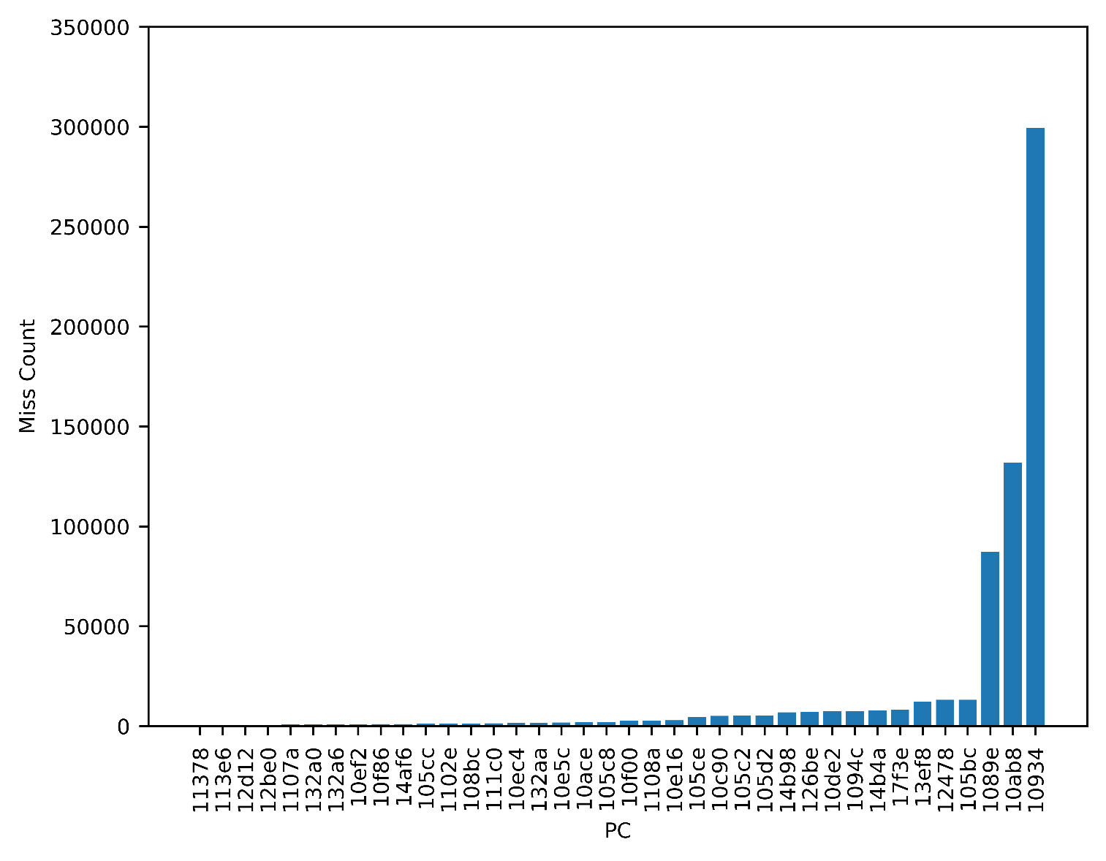
Test – Libquantum

Slide 14
Libquantum
void
quantum_toffoli(int control1, int control2, int target, quantum_reg *reg)
{
int i;
int qec;
quantum_qec_get_status(&qec, NULL);
if(qec)
quantum_toffoli_ft(control1, control2, target, reg);
else
{
if(quantum_objcode_put(TOFFOLI, control1, control2, target))
return;
for(i=0; i<reg->size; i++)
{
/* Flip the target bit of a basis state if both control bits are
set */
if(reg->node[i].state & ((MAX_UNSIGNED) 1 << control1))
{
if(reg->node[i].state & ((MAX_UNSIGNED) 1 << control2))
{
reg->node[i].state ^= ((MAX_UNSIGNED) 1 << target);
}
}
}
quantum_decohere(reg);
}
}
00000000000108c8 <quantum_toffoli>:
…
1090a: 197020ef jal ra,132a0 <quantum_objcode_put>
1090e: f17d bnez a0,108f4 <quantum_toffoli+0x2c>
10910: 40d4 lw a3,4(s1)
10912: 02d05a63 blez a3,10946 <quantum_toffoli+0x7e>
10916: 4785 li a5,1
10918: 00879433 sll s0,a5,s0
1091c: 01279933 sll s2,a5,s2
10920: 012465b3 or a1,s0,s2
10924: 01379633 sll a2,a5,s3
10928: 4701 li a4,0
1092a: 689c ld a5,16(s1)
1092c: 00471513 slli a0,a4,0x4
10930: 0705 addi a4,a4,1
10932: 97aa add a5,a5,a0
10934: 6788 ld a0,8(a5)
10936: 0007081b sext.w a6,a4
1093a: 00b578b3 and a7,a0,a1
1093e: 01158e63 beq a1,a7,1095a <quantum_toffoli+0x92>
10942: fed844e3 blt a6,a3,1092a <quantum_toffoli+0x62>
…
10958: 8082 ret
1095a: 8d31 xor a0,a0,a2
1095c: e788 sd a0,8(a5)
1095e: 40d4 lw a3,4(s1)
10960: fcd845e3 blt a6,a3,1092a <quantum_toffoli+0x62>
10964: b7cd j 10946 <quantum_toffoli+0x7e>

Slide 15
Libquantum
void
quantum_sigma_x(int target, quantum_reg *reg)
{
int i;
int qec;
quantum_qec_get_status(&qec, NULL);
if(qec)
quantum_sigma_x_ft(target, reg);
else
{
if(quantum_objcode_put(SIGMA_X, target))
return;
for(i=0; i<reg->size; i++)
{
/* Flip the target bit of each basis state */
reg->node[i].state ^= ((MAX_UNSIGNED) 1 << target);
}
quantum_decohere(reg);
}
}
0000000000010a6c <quantum_sigma_x>:
…
10a9a: 007020ef jal ra,132a0 <quantum_objcode_put>
10a9e: f57d bnez a0,10a8c <quantum_sigma_x+0x20>
10aa0: 405c lw a5,4(s0)
10aa2: 4585 li a1,1
10aa4: 009595b3 sll a1,a1,s1
10aa8: 4701 li a4,0
10aaa: 00f05f63 blez a5,10ac8 <quantum_sigma_x+0x5c>
10aae: 681c ld a5,16(s0)
10ab0: 00471693 slli a3,a4,0x4
10ab4: 0705 addi a4,a4,1
10ab6: 97b6 add a5,a5,a3
10ab8: 6794 ld a3,8(a5)
10aba: 0007061b sext.w a2,a4
10abe: 8ead xor a3,a3,a1
10ac0: e794 sd a3,8(a5)
10ac2: 405c lw a5,4(s0)
10ac4: fef645e3 blt a2,a5,10aae <quantum_sigma_x+0x42>
10ac8: 8522 mv a0,s0
10aca: af1ff0ef jal ra,105ba <quantum_decohere>
10ace: 70a2 ld ra,40(sp)
10ad0: 7402 ld s0,32(sp)
10ad2: 64e2 ld s1,24(sp)
10ad4: 6145 addi sp,sp,48
10ad6: 8082 ret

Slide 16
Libquantum
0000000000010842 <quantum_cnot>:
…
1087a: 227020ef jal ra,132a0 <quantum_objcode_put>
1087e: f56d bnez a0,10868 <quantum_cnot+0x26>
10880: 00442883 lw a7,4(s0)
10884: 03105963 blez a7,108b6 <quantum_cnot+0x74>
10888: 4585 li a1,1
1088a: 00959533 sll a0,a1,s1
1088e: 4681 li a3,0
10890: 012595b3 sll a1,a1,s2
10894: 6818 ld a4,16(s0)
10896: 00469793 slli a5,a3,0x4
1089a: 0685 addi a3,a3,1
1089c: 973e add a4,a4,a5
1089e: 671c ld a5,8(a4)
108a0: 0006881b sext.w a6,a3
108a4: 00b7c633 xor a2,a5,a1
108a8: 8fe9 and a5,a5,a0
108aa: c781 beqz a5,108b2 <quantum_cnot+0x70>
…
108c6: 8082 ret
void
quantum_cnot(int control, int target, quantum_reg *reg)
{
int i;
int qec;
quantum_qec_get_status(&qec, NULL);
if(qec)
quantum_cnot_ft(control, target, reg);
else
{
if(quantum_objcode_put(CNOT, control, target))
return;
for(i=0; i<reg->size; i++)
{
/* Flip the target bit of a basis state if the control bit is set */
if((reg->node[i].state & ((MAX_UNSIGNED) 1 << control)))
reg->node[i].state ^= ((MAX_UNSIGNED) 1 << target);
}
quantum_decohere(reg);
}
}

Slide 17
Libquantum - PF
Void quantum_toffoli(int control1, int control2, int target, quantum_reg *reg)
{
int i;
int qec;
quantum_qec_get_status(&qec, NULL);
if(qec)
quantum_toffoli_ft(control1, control2, target, reg);
else
{
if(quantum_objcode_put(TOFFOLI, control1, control2, target))
return;
for(i=0; i<reg->size; i++)
{
/* Flip the target bit of a basis state if both control bits are
set */
asm volatile ("prefetch.r %[addr]": : [addr]"A"(reg->node[i + 8].state));
if(reg->node[i].state & ((MAX_UNSIGNED) 1 << control1))
{
if(reg->node[i].state & ((MAX_UNSIGNED) 1 << control2))
{
reg->node[i].state ^= ((MAX_UNSIGNED) 1 << target);
}
}
}
quantum_decohere(reg);
}
}

Slide 18
SPEC 2006 -- TEST
Settings | IPC | Clock Cycles
No Prefetcher | 2.472886 | 119204387
SPP | 2.453326 | 120154765
SW Prefetch Insts (Stride 4) | 2.805613 | 133765936
SW Prefetch Insts (Stride 8) | 2.820752 | 133048018

Slide 19


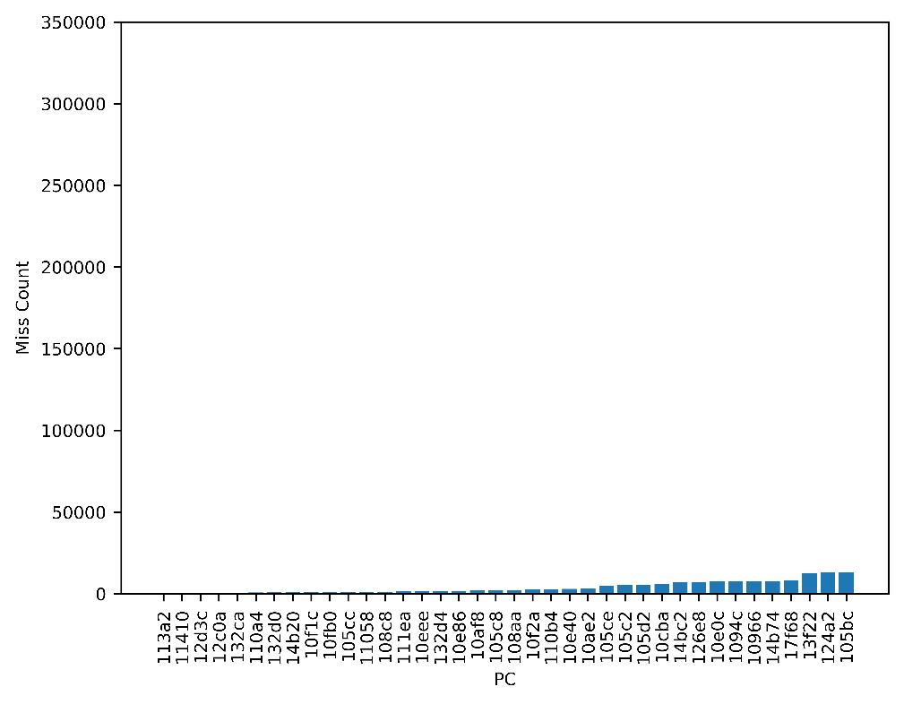
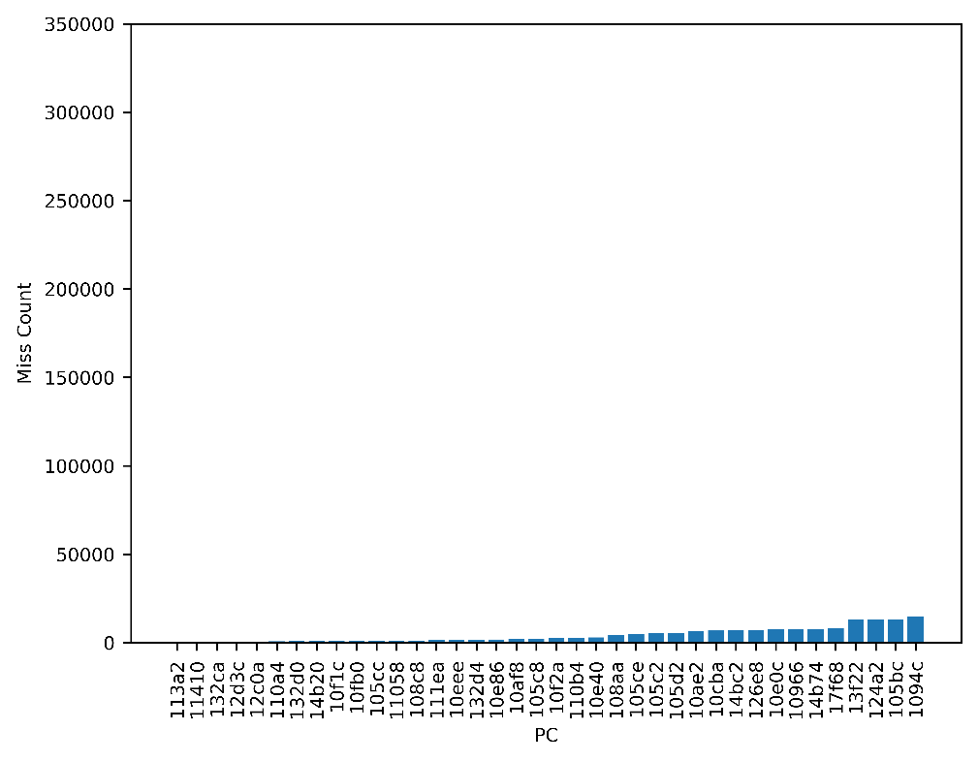
NO Prefetcher
SPP
SW Prefetch
(stride 4)
SW Prefetch
(stride 8)

Slide 20
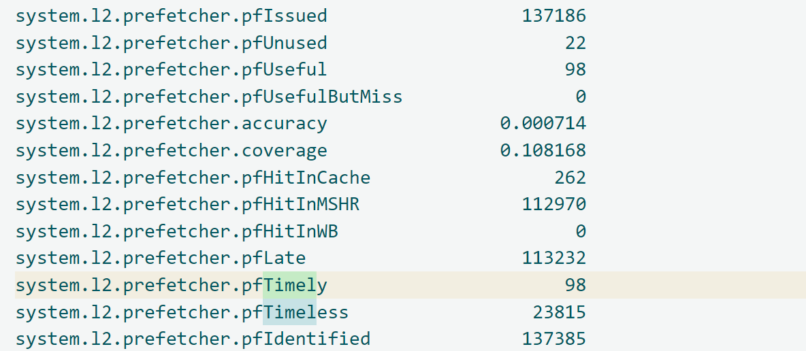
SPEC 2006 -- TEST

Slide 21
Support RISC-V Prefetch Instructions in Gem5

